Slide 1
Glossy Probe Reprojection for Interactive Global Illumination
20140159 Kim Hajun

Slide 2
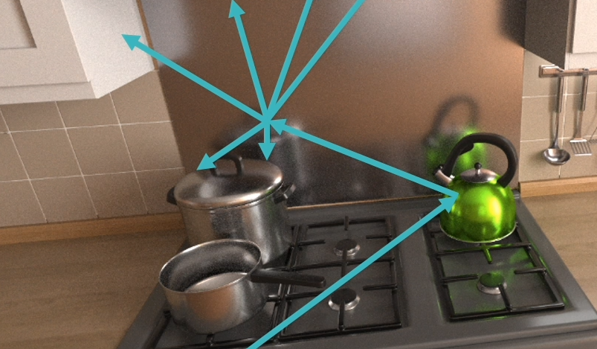
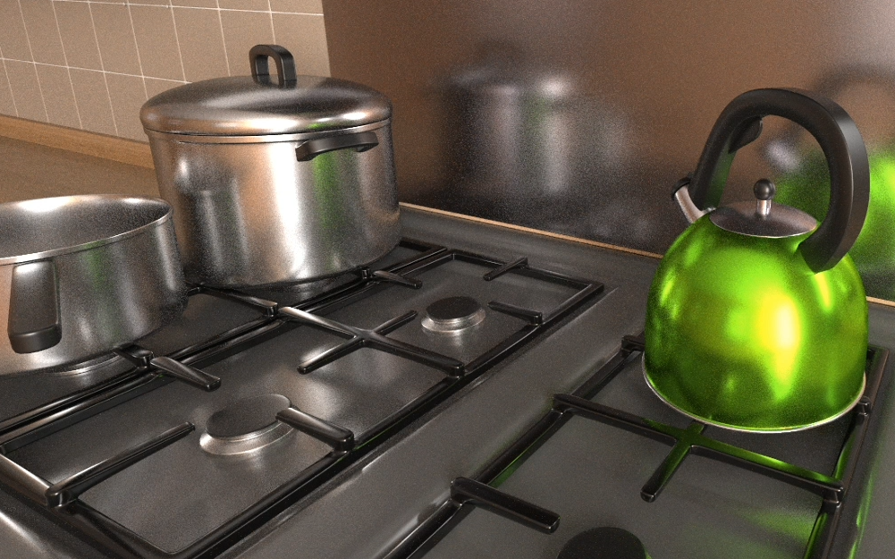
What To Do?
Condition
Static scene + Dynamic view + Opaque objects
Goal
Render complex light paths with multiple glossy interactions

Slide 3
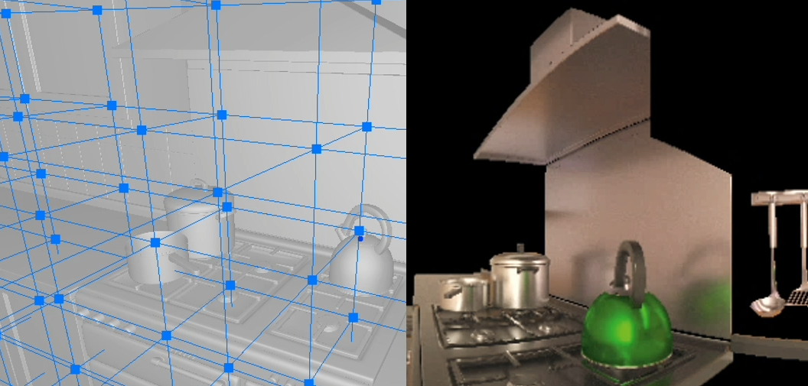
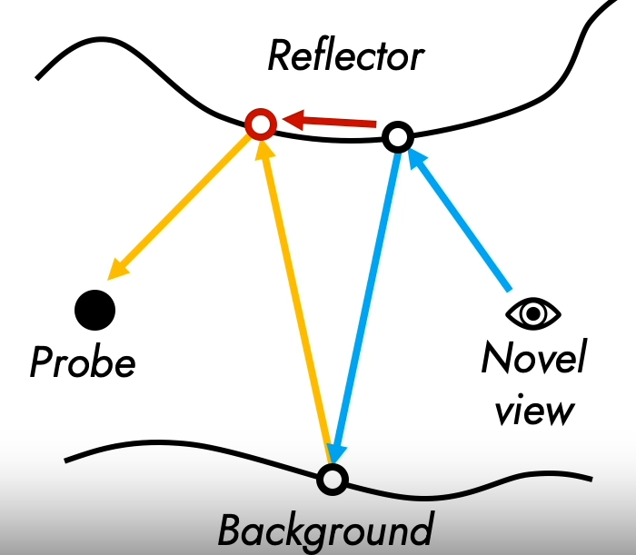
Glossy Probe Reprojection
In this paper, Glossy == Non-diffuse
Probe
Lots of use in baked-rendering
Stores information about surroundings
i.e. A cubemap that is rendered from its origin
Reprojection
Projection == Novel view -> Background
Reprojection == Background -> Probe
Estimates Reflector == Find sample point

Slide 4
Interactive Global Illumination
In this paper, Interactive == Dynamic view
Dynamic view ~= Novel view
Dynamic view position
Dynamic view orientation
But static scene
Yet another real-time global illumination approximation

Slide 5
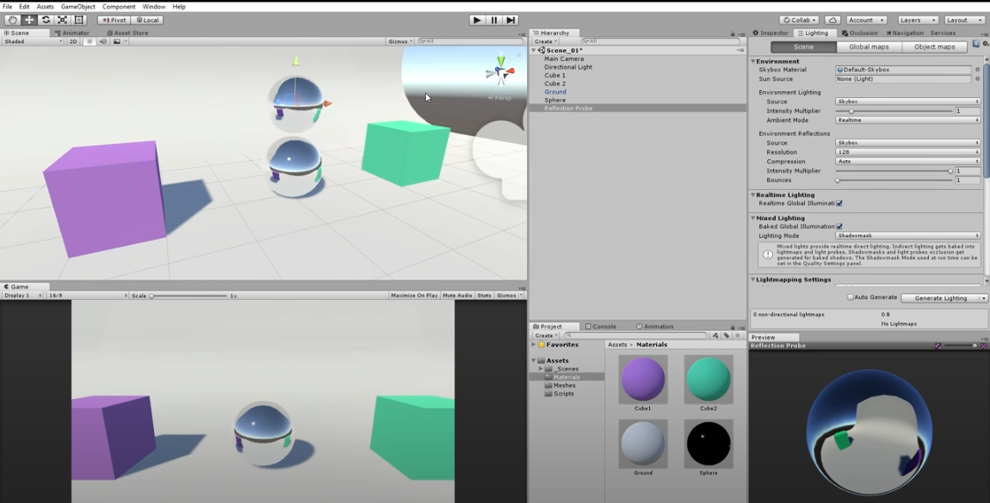
Why Not Reflection Probe?
Capture surroundings + Use environment mapping
Not capturing num(bounces) > 1 indirect light
== multiple bounce glossy path

Slide 6
Why Not Ray Tracing?
Requires high sample count
Hard to capture details
High geometric complexity
Smooth surfaces
Limitation of existing denoisers
Reconstruction of dynamic glossy and specular reflections from low-sample renderings is a known limitation of existing denoisers.

Slide 7
Overview
Separate diffuse, specular lighting contributions
Diffuse part pre-computed by path-tracing

Slide 8
Three Challenges
Reducing memory footprint of the probes
Efficiently and accurately reprojecting glossy path information to the novel view
Avoiding sharpening at glossy reflection occlusion boundaries

Slide 9
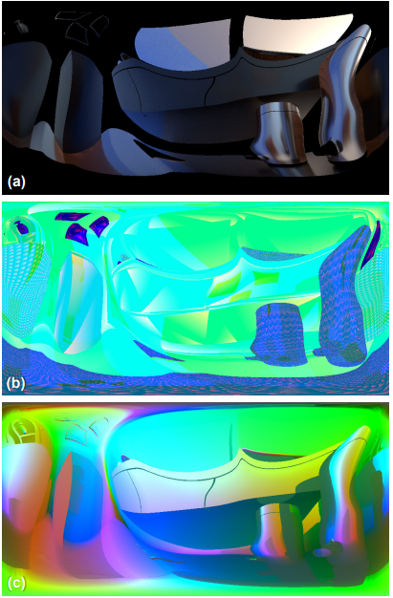
1. Probe Generation And Storage
Adaptive light probe parameterization
== more storage for detailed regions
For each probe
(a) Glossy color
By path-tracing specular lobe
(b) Reflector geometry information
(c) Reflected positions
(b), (c) used for reflection estimation

Slide 10
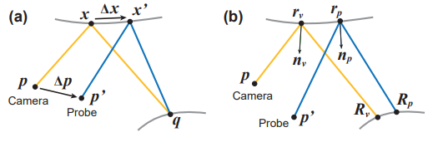
2. Rendering Global Illumination
For each nearby probe in probe grid (8 of them)
(a) Estimate reflection point by reprojection
Sample glossy color from estimated reflection point
(b) Assess probe sample and determine whether if it’s useful
Get the result(glossy color) by trilinear interpolation

Slide 11
3. Accurate Warping of Glossy Probes
Sharpened boundary
Two-step convolution
(e) Ground truth
(f) Naïve
(g) Step 1
(h) Step 2

Slide 12
Revisit

Slide 13
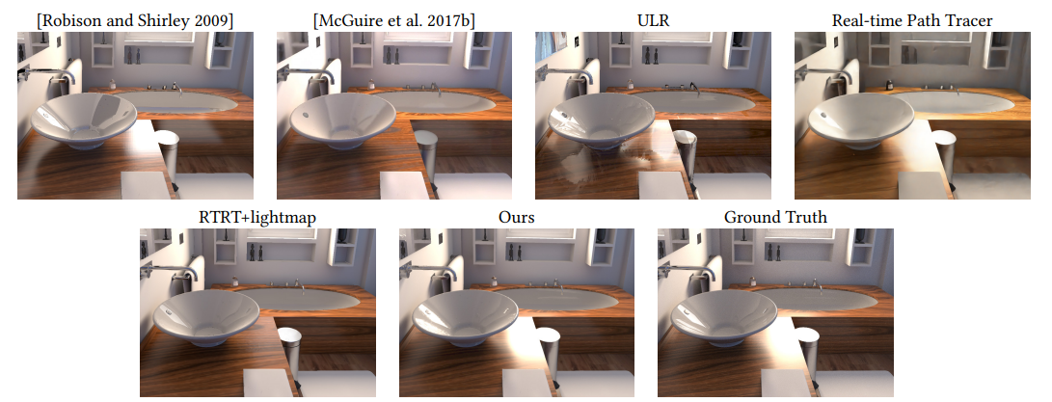
Result
Compared to state of art
Similar framerate with higher quality

